Slide 1
Software Developer
College & Career Day
Pinckneyville Middle School
Sean McPherson

Slide 2
👋 Hey, I’m Sean

Slide 3


Slide 4
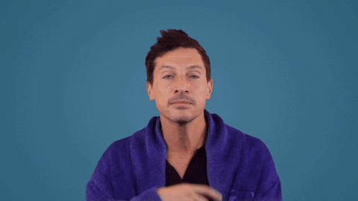
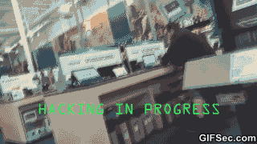

Slide 5
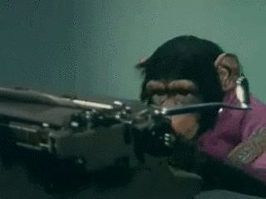

Slide 6

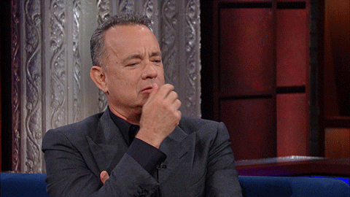

Slide 7


Slide 8
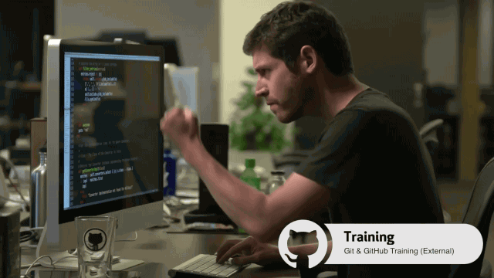

Slide 9
Background
Graduated from Edinboro University ‘14
Taught for three years
Juvenile detention center
AmeriCorps KeystoneSMILES
Chesney Elementary (GCPS)
Graduated from the Iron Yard ‘17
Started at TSYS ‘18

Slide 10
Software Developer Software Engineer Computer programmer

Slide 11
Teach computers to solve problems

Slide 12
Made by software developers
YouTube
musical.ly
FIFA
TikTok
Fortnite
Instagram
Internet
Computers
Smartwatches
Satellites
Space station
Artificial limbs

Slide 13
Computer Science 101
How to teach computers to do your homework for you

Slide 14
Variables
Way to store data
Words
Numbers
True/false
Lists
etc.

Slide 15
Variables example
var greeting = “Hello world!”
greeting
// “Hello world!”

Slide 16
Variables example
var name = “Sean”
var age = 72
var is_female = false
var hobbies = [“coding”, “reading”, “soccer”]

Slide 17
Functions
Little robot that does something
Takes in (input)
Gives out (output)

Slide 18
Functions example
function name_of_function(input) {
return output
}

Slide 19
Categorizing with if
function is_my_name(name) {
if (name === ”Sean”)
return ”Yes, it’s my name!”
}
* === means equal

Slide 20
Additional conditionals
function greet_student(is_student, is_present) {
if (is_student && is_present)
return ”Welcome to class!”
}
* && means and

Slide 21
Categorizing shapes
{
"id": 1,
"side_count": 3,
"is_closed": true
}
// What info can help me identify the shape?

Slide 22
Categorizing shapes
function categorize_shape(shape) {
if (shape.side_count === 3)
return “triangle”
}
{
"id": 1,
"side_count": 3,
"is_closed": true
}

Slide 23
Categorizing shapes
{
"id": 2,
"side_count": 4,
"is_closed": true
}

Slide 24
Categorizing shapes
function categorize_shape(shape) {
if (shape.side_count === 3)
return “triangle”
if (shape.side_count === 4)
return “rectangle”
}
{
"id": 2,
"side_count": 4,
"is_closed": true
}

Slide 25
Categorizing organisms
{
"id": 1,
"age": 105120,
"blood_temp": "warm",
"habitat": "land",
"lays_eggs": false
},
{
"id": 2,
"age": 84096,
"blood_temp": "warm",
"habitat": "land",
"lays_eggs": true
},
{
"id": 3,
"age": 35040,
"blood_temp": "cold",
"habitat": "water",
"lays_eggs": true
},
{
"id": 4,
"age": 13140,
"blood_temp": "cold",
"habitat": "land",
"lays_eggs": true
}
Hint: bird (1), fish (1), mammal (1), reptile (1)

Slide 26
Categorizing organisms
function categorize_organism(org) {
if (
org.blood_temp === “warm” &&
org.habitat === “land”
)
return “mammal”
}
{
"id": 1,
"age": 105120,
"blood_temp": "warm",
"habitat": "land",
"lays_eggs": false
}

Slide 27
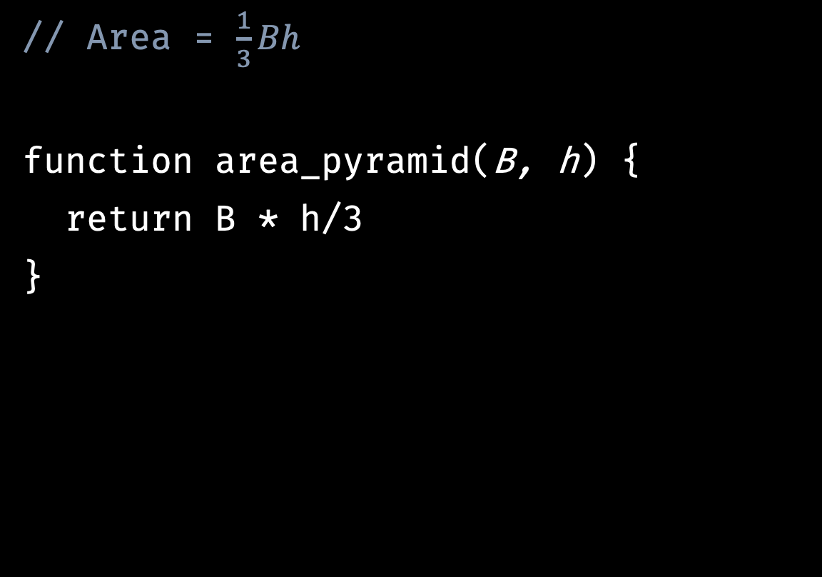
Area of a pyramid
// Area = $\frac{1}{3}Bh$
function area_pyramid(B, h) {
return B * h/3
}
area_pyramid(16, 6)
// 32
area_pyramid(9, 9)
// 27
area_pyramid(49, 18)
// 147

Slide 28
Who can become a software developer?

Slide 29
Anyone! Yes, that includes you!

Slide 30
What does a software developer look like?

Slide 31
👨🏿‍💻👩🏻‍💻👨🏾‍💻👩🏼‍💻👨🏽‍💻👩🏽‍💻👨🏼‍💻👩🏾‍💻👨🏻‍💻👩🏿‍💻 👩🏽‍💻👨🏼‍💻👩🏾‍💻👨🏻‍💻👩🏿‍💻👨🏿‍💻👩🏻‍💻👨🏾‍💻👩🏼‍💻👨🏽‍💻 👨🏿‍💻👩🏻‍💻👨🏾‍💻👩🏼‍💻👨🏽‍💻👩🏽‍💻👨🏼‍💻👩🏾‍💻👨🏻‍💻👩🏿‍💻 👩🏽‍💻👨🏼‍💻👩🏾‍💻👨🏻‍💻👩🏿‍💻👨🏿‍💻👩🏻‍💻👨🏾‍💻👩🏼‍💻👨🏽‍💻 👨🏿‍💻👩🏻‍💻👨🏾‍💻👩🏼‍💻👨🏽‍💻👩🏽‍💻👨🏼‍💻👩🏾‍💻👨🏻‍💻👩🏿‍💻 👩🏽‍💻👨🏼‍💻👩🏾‍💻👨🏻‍💻👩🏿‍💻👨🏿‍💻👩🏻‍💻👨🏾‍💻👩🏼‍💻👨🏽‍💻

Slide 32
How to become a software developer?

Slide 33
How to become a software developer, part 1
Enjoy solving problems
Enjoy using a computer
Practice coding
Build a website
Make an app
Write a script
Go to a coding summer camp // optional
Take coding electives in high school

Slide 34
How to become a software developer, part 2
Option 1: Go to a four-year college
Major in Computer Science or Software Engineering
Do fun and challenging internships
Option 2: Go to a two-year tech school
Major in Computer Science or Software Engineering
Graduate early and start working
Option 3: Go to a coding bootcamp // <-- Me
Study web development in a particular language
Learn on the job

Slide 35
Go out and solve some cool problems!

Slide 36
Questions?

